Slide 1
Mutex Locks
Solve critical section problems using OS
Mutex lock: protect a critical section
acquire() a lock
release() the lock
acquire() and release() must be atomic
This solution requires busy waiting
Notes:
Previous solutions are complicated and generally inaccessible to application programmers
OS designers build software tools to solve critical section problem
Simplest is mutex lock
Protect a critical section by first acquire() a lock then release() the lock
Boolean variable indicating if lock is available or not
Calls to acquire() and release() must be atomic
Usually implemented via hardware atomic instructions
But this solution requires busy waiting
This lock therefore called a spinlock

Slide 2
acquire()
acquire() { while (!available)
; /* busy wait */
available = false;
}
It is locked!
Locked it!

Slide 3
Exercise 2: Please complete the following code. release()
release() {
available = true;
}
do {
acquire lock
critical section
release lock
remainder section
} while (true);

Slide 4
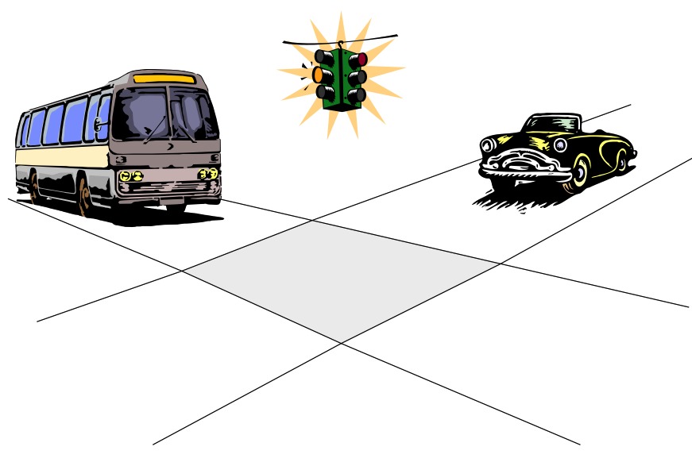
Semaphore
Notes:
History: John Peake Knight is credited with inventing the original traffic light in 1868, a semaphore system based on railway signalling. In 1866, a year in which 1102 people were killed and 1334 injured on roads in London, he proposed a signalling system to regulate the horse-drawn traffic and reduce the number of road accidents.
Invented in the 1960s by Dijkstra
Conceptual OS mechanism, with no specific implementation defined (could be enter()/exit())
Basis of all contemporary OS synchronization mechanisms
The fundamental principle is this: Two or more processes can cooperate by means of simple signals, such that a process can be forced to stop at a specified place until it has received a specific signal. Any complex coordination requirement can be satisfied by the appropriate structure of signals. For signaling, special variables called semaphores are used. To transmit a signal via semaphore s , a process executes the primitive semSignal(s) . To receive a signal via semaphore s , a process executes the primitive semWait(s) ; if the corresponding signal has not yet been transmitted, the process is suspended until the transmission takes place.
To achieve the desired effect, we can view the semaphore as a variable that has an integer value upon which only three operations are defined:
1. A semaphore may be initialized to a nonnegative integer value.
2. The semWait operation decrements the semaphore value. If the value becomes negative, then the process executing the semWait is blocked.
Otherwise, the process continues execution.
3. The semSignal operation increments the semaphore value. If the resulting value is less than or equal to zero, then a process blocked by a semWait operation, if any, is unblocked. Other than these three operations, there is no way to inspect or manipulate semaphores.
We explain these operations as follows. To begin, the semaphore has a zero or positive value. If the value is positive, that value equals the number of processes that can issue a wait and immediately continue to execute. If the value is zero, either by initialization or because a number of processes equal to the initial semaphore value have issued a wait, the next process to issue a wait is blocked, and the semaphore value goes negative. Each subsequent wait drives the semaphore value further into minus territory. The negative value equals the number of processes waiting to be unblocked. Each signal unblocks one of the waiting processes when the semaphore value is negative.

Slide 5
Semaphore
Semaphore S: integer variable
Two atomic operations
wait() and signal()
Also called P() and V()
Counting semaphore – integer value can range over an unrestricted domain
Binary semaphore – integer value can range only between 0 and 1
Same as a mutex lock
Notes:
Synchronization tool that provides more sophisticated ways (than Mutex locks) for process to synchronize their activities.
Semaphore S – integer variable
Can only be accessed via two indivisible (atomic) operations
wait() and signal()
Originally called P() and V()
Definition of the wait() operation
wait(S) {
while (S <= 0)
; // busy wait
S--;
}
Definition of the signal() operation
signal(S) {
S++;
}

Slide 6


Counting vs. Binary Semaphore
Binary semaphore – integer value can range only between 0 and 1
Same as a mutex lock
Counting semaphore – integer value can range over an unrestricted domain
Notes:
Synchronization tool that provides more sophisticated ways (than Mutex locks) for process to synchronize their activities.
Semaphore S – integer variable
Can only be accessed via two indivisible (atomic) operations
wait() and signal()
Originally called P() and V()
Definition of the wait() operation
wait(S) {
while (S <= 0)
; // busy wait
S--;
}
Definition of the signal() operation
signal(S) {
S++;
}

Slide 7

Notes:
I am not a ventriloquist.

Slide 8
Exercise 3: Can you explain these operations? How can a waiting process be signaled to proceed?
wait(S) {
while (S <= 0)
; // busy wait
S--;
}
signal(S) {
S++;
}
Notes:
Synchronization tool that provides more sophisticated ways (than Mutex locks) for process to synchronize their activities.
Semaphore S – integer variable
Can only be accessed via two indivisible (atomic) operations
wait() and signal()
Originally called P() and V()
Definition of the wait() operation
wait(S) {
while (S <= 0)
; // busy wait
S--;
}
Definition of the signal() operation
signal(S) {
S++;
}

Slide 9
Sample Semaphore Usage
Can solve various synchronization problems
Consider P₁ and P₂ that require S₁ to happen before S₂
How to use semaphore “sync” on the two processes?
Exercise 4: How to initialize “sync”?
Create a semaphore “sync” initialized to 0
P1:
S₁;
signal(sync);
P2:
wait(sync);
S₂;
Notes:
Must guarantee that no two processes can execute the wait() and signal() on the same semaphore at the same time
Thus, the implementation becomes the critical section problem where the wait and signal code are placed in the critical section
Could now have busy waiting in critical section implementation
But implementation code is short
Little busy waiting if critical section rarely occupied
Note that applications may spend lots of time in critical sections and therefore this is not a good solution
Can implement a counting semaphore S as a binary semaphore

Slide 10
COMP 3500 Introduction to Operating Systems Synchronization: Part 4 Classical Synchronization Problems
Dr. Xiao Qin
Auburn University http://www.eng.auburn.edu/~xqin
xqin@auburn.edu
Notes:
Fall’17: 50 Minutes Slides 1-18
Spring’17:
04c1-Project 3-1 Overview: 10 Minutes
From 04b-Synchronization 3-Semaphore. See also slides 1-5. 20 Minutes
Slides 6-18: 20 Minutes:
Fall’16
50 Minutes: Slides 1-10.
Ex 1-7.

Slide 11
Exercise 1: What is item “L” in the semaphore structure? What is the purpose of this item?
typedef struct {
int value; struct process *L; } semaphore;
wait(semaphore *S) { /* New */
S->value--;
if (S->value < 0) { add this process to S->list;
block();
}
}
signal(semaphore *S) {/* New */
S->value++;
if (S->value <= 0) { remove a process P from S->list;
wakeup(P);
}
}
wait(S) { /* Old */
while (S <= 0)
; // busy wait
S--;
}
signal(S) { /* Old */
S++;
}

Slide 12
Exercise 1 (Plickers): Which one of the following statement about item “L” in the semaphore structure is incorrect? A. It is a waiting queue. B. It doesn’t waste CPU time. C. It avoids busy waiting for a signal. D. It doesn’t wait for a signal
typedef struct {
int value; struct process *L; } semaphore;

Slide 13
Semaphore Implementation with no Busy waiting
A semaphore: there is an associated waiting queue
Each entry in a waiting queue has two data items:
value (of type integer)
pointer to next record in the list
Two operations:
block – place the process invoking the operation on the appropriate waiting queue
wakeup – remove one of processes in the waiting queue and place it in the ready queue
typedef struct {
int value; struct process *L; } semaphore;

Slide 14
Implementation with no Busy waiting (Cont.)
wait(semaphore *S) {
S->value--;
if (S->value < 0) { add this process to S->list;
block();
}
}
signal(semaphore *S) {
S->value++;
if (S->value <= 0) { remove a process P from S->list;
wakeup(P);
}
}

Slide 15
Deadlock and Starvation
Deadlock – two or more processes are waiting indefinitely
Let S and Q be two semaphores initialized to 1
P₀ P₁
wait(S); wait(Q);
wait(Q); wait(S);
... ...
signal(S); signal(Q);
signal(Q); signal(S);
Starvation – indefinite blocking
A process never be removed from the semaphore queue
Notes:
Deadlock – two or more processes are waiting indefinitely for an event that can be caused by only one of the waiting processes
Let S and Q be two semaphores initialized to 1
P₀ P₁
wait(S); wait(Q);
wait(Q); wait(S);
... ...
signal(S); signal(Q);
signal(Q); signal(S);
Starvation – indefinite blocking
A process may never be removed from the semaphore queue in which it is suspended
Priority Inversion – Scheduling problem when lower-priority process holds a lock needed by higher-priority process
Solved via priority-inheritance protocol

Slide 16
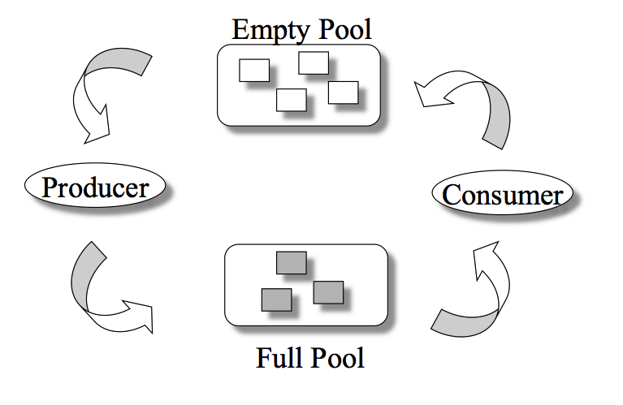
The Bounded-Buffer Problem
Exercise 2: What semaphores do you need to control the shared pool?
n buffers, each can hold one item
Notes:
Semaphore mutex: initial value 1
Semaphore full: initial value 0
Semaphore empty initial value n
Classical Problems of Synchronization
Classical problems used to test newly-proposed synchronization schemes
Bounded-Buffer Problem
Readers and Writers Problem
Dining-Philosophers Problem
Semaphore mutex initialized to the value 1
Semaphore full initialized to the value 0
Semaphore empty initialized to the value n

Slide 17
The Bounded-Buffer Problem
Exercise 2.1 (Plickers): What is the initial value of mutex?
-1
0
1
n
Notes:
Semaphore mutex: initial value 1
Semaphore full: initial value 0
Semaphore empty initial value n
Classical Problems of Synchronization
Classical problems used to test newly-proposed synchronization schemes
Bounded-Buffer Problem
Readers and Writers Problem
Dining-Philosophers Problem
Semaphore mutex initialized to the value 1
Semaphore full initialized to the value 0
Semaphore empty initialized to the value n

Slide 18
The Bounded-Buffer Problem
Exercise 2.2 (Plickers):
What is the initial value of full (full_bucket)?
-1
0
1
n
Notes:
Semaphore mutex: initial value 1
Semaphore full: initial value 0
Semaphore empty initial value n
Classical Problems of Synchronization
Classical problems used to test newly-proposed synchronization schemes
Bounded-Buffer Problem
Readers and Writers Problem
Dining-Philosophers Problem
Semaphore mutex initialized to the value 1
Semaphore full initialized to the value 0
Semaphore empty initialized to the value n

Slide 19
The Bounded-Buffer Problem
Exercise 2.3 (Plickers):
What is the initial value of empty (empty _bucket)?
-1
0
1
n
Notes:
Semaphore mutex: initial value 1
Semaphore full (full_bucket): initial value 0
Semaphore empty (empty_bucket) initial value n
Classical Problems of Synchronization
Classical problems used to test newly-proposed synchronization schemes
Bounded-Buffer Problem
Readers and Writers Problem
Dining-Philosophers Problem
Semaphore mutex initialized to the value 1
Semaphore full initialized to the value 0
Semaphore empty initialized to the value n

Slide 20
The Producer Process
Exercise 3: Where to place the mutex semaphore?
do {
... /* produce an item in next_produced */
...
wait(empty);
wait(mutex);
... /* add next produced to the buffer */
...
signal(mutex);
signal(full);
} while (true);

Slide 21
Exercise 4: Can you design a consumer process?
Do {
wait(full);
wait(mutex);
... /* remove an item from buffer to
next_consumed */
...
signal(mutex);
signal(empty);
... /* consume the item in next consumed */
... } while (true);

Slide 22
Summary
Semaphore
The Bounded-Buffer Problem
Next Lecture:
The Readers-Writers Problem
The Dining-Philosophers Problem
Introduction to Monitors
Notes:
Summary of Chapter 5.

Slide 23

The Readers-Writers Problem
Concurrent processes
Readers – only read data; do not perform updates
Writers – both read and write
Problem:
Allow multiple readers to read at the same time
Only one single writer can access the shared data
Exercise 5: What semaphores do we need?
Semaphore rw_mutex initialized to 1
Semaphore mutex initialized to 1
Integer read_count initialized to 0
Notes:
A data set is shared among a number of concurrent processes
Readers – only read the data set; they do not perform any updates
Writers – can both read and write
Problem – allow multiple readers to read at the same time
Only one single writer can access the shared data at the same time
Several variations of how readers and writers are considered – all involve some form of priorities
Shared Data
Data set
Semaphore rw_mutex initialized to 1
Semaphore mutex initialized to 1
Integer read_count initialized to 0

Slide 24
The Writer Process Exercise 6: Which semaphore should we use here?
Question: Is it a semaphore or lock?
do { wait(rw_mutex);
... /* writing is performed */
...
signal(rw_mutex);
} while (true);
Only one single writer can access the shared data

Slide 25
The Reader Process Exercise 7: Can you explain the following process?
do { wait(mutex); read_count++; if (read_count == 1)
wait(rw_mutex);
signal(mutex);
... /* reading is performed */
...
wait(mutex); read count--; if (read_count == 0)
signal(rw_mutex);
signal(mutex);
} while (true);
A writer is in the critical section, n readers are waiting. Then …
n-1 wait here
1st waits here
Critical section?
Let a writer access
Multiple readers can access the shared data

Slide 26
Other Readers-Writers Problems
Problem 1: no reader kept waiting unless writer has permission to use shared object
Problem 2: once writer is ready, it performs the write ASAP
Both may have starvation
Notes:
Problem is solved on some systems by kernel providing reader-writer locks

Slide 27
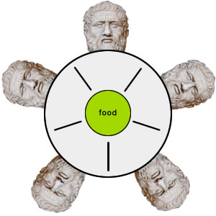
The Dining-Philosophers Problem
Philosophers spend their lives thinking and eating
Occasionally try to pick up 2 chopsticks (one at a time) to eat from bowl
In the case of 5 philosophers: Shared data
Bowl of rice
Semaphore chopstick [5] initialized to 1
Notes:
Philosophers spend their lives alternating thinking and eating
Don’t interact with their neighbors, occasionally try to pick up 2 chopsticks (one at a time) to eat from bowl
Need both to eat, then release both when done
In the case of 5 philosophers
Shared data
Bowl of rice (data set)
Semaphore chopstick [5] initialized to 1

Slide 28
The structure of Philosopher i
do {
wait (chopstick[i] );
wait (chopStick[ (i + 1) % 5] );
// eat
signal (chopstick[i] );
signal (chopstick[ (i + 1) % 5] );
// think
} while (TRUE);
Exercise 8: What is the problem with this algorithm?

Slide 29
Deadlock Handling
Allow at most 4 philosophers to be sitting simultaneously at the table.
Allow a philosopher to pick up the forks only if both are available (picking must be done in a critical section.
Use an asymmetric solution -- an odd-numbered philosopher picks up first the left chopstick and then the right chopstick. Even-numbered philosopher picks up first the right chopstick and then the left chopstick.
Notes:
Allow at most 4 philosophers to be sitting simultaneously at the table.
Allow a philosopher to pick up the forks only if both are available (picking must be done in a critical section.
Use an asymmetric solution -- an odd-numbered philosopher picks up first the left chopstick and then the right chopstick. Even-numbered philosopher picks up first the right chopstick and then the left chopstick.

Slide 30
Problems with Semaphores
Incorrect use of semaphore operations:
signal (mutex) …. wait (mutex)
wait (mutex) … wait (mutex)
Omitting of wait (mutex) or signal (mutex) (or both)
Deadlock and starvation are possible.

Slide 31
Monitors
A high-level abstraction for process synchronization
Abstract data type: internal variables only accessible by code within the procedure
Only one process may be active within the monitor at a time
But not powerful enough to model some synchronization schemes
monitor monitor-name
{
// shared variable declarations
procedure P1 (…) { …. }
procedure Pn (…) {……}
Initialization code (…) { … }
}
Notes:
A high-level abstraction that provides a convenient and effective mechanism for process synchronization
Abstract data type, internal variables only accessible by code within the procedure
Only one process may be active within the monitor at a time
But not powerful enough to model some synchronization schemes

Slide 32
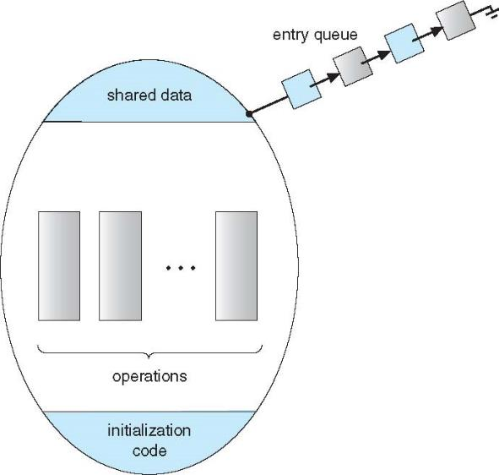
A Monitor

